Slide 1
Hearing Loss Prevention
Army Hearing Program
Readiness, Operational, Hearing Conservation, Clinical
Approved for public release, unlimited distribution

Slide 2
BRIEFING OUTLINE
PURPOSE: To provide strategies for effectively minimizing noise-related threats on and off the job.
1. Hearing & Noise
2. Hazardous Noise Levels
3. Hearing Protection
4. Audiometric (hearing) testing
5. Noise records (your rights)
6. Conclusion

Slide 3
Noise Exposure Threat
Permanent Hearing Loss = Top Four Injuries in Current Operational Environment
Exposure to loud noise will cause hearing loss over time
Hearing Loss is an injury that occurs without pain
No sensory nerves in the inner ear (cochlea)
Gradual or Sudden – no way to predict who is susceptibility to loss
Always Cumulative
Tinnitus, or permanent ringing in the ear
Notes:
Permanent hearing loss is one of the most under identified injuries due to the nature of the symptoms. Although symptoms include temporary hearing loss (“muffled sounds”) and tinnitus (ringing in the ears), it does not include pain. Complicating matters, the initial symptoms often improve in time and there are no visible signs of the injury (i.e.; blood), leaving the individual with the impression that the injury is not permanent and has left no damage behind. Once damage to the inner begins, it leaves the employee vulnerable to a gradual or sudden decline in hearing with continued exposures.
Damage to the ear from exposure to excessive noise is permanent. Exposure to excessively loud noise can occur any where: at work, at home, or at play. Power tools, recreational equipment, music or headphones can all generate excessive noise.

Slide 4
Response to the threat of loud noise: The Army Hearing Program Readiness, Operational, Hearing Conservation, Clinical
Prevention & Education are Key
Understand the threat of loud noise
Employ strategies to minimize the threat
Notes:
Education and Preventive measures are the key to mitigating the threat. Understand the threat, its potential impact, and how to stop the injury before it starts.

Slide 5
Exposure to Noise over Time
Our ears can recover from short exposure to loud noise but, over time, permanent nerve damage will occur
The longer and louder the noise, the greater the chance permanent damage will occur
Ears do not “get used to” the noise
Notes:
The damage from exposure to noise occurs in the inner the ear (the cochlea). There are tiny hair cells in this part of the ear that are “flattened out” when exposed to noise. If the exposure is short, the hair cells raise back up, similar to blades of grass after you stepped on them. After repeated stepping on the grass eventually the blade will not “bounce back”. The tiny hair cells in the inner ear also do not “bounce back” if the noise exposure is long or extremely loud and hearing loss occurs. When all the hair cells are damaged, complete deafness occurs.

Slide 6
CONSEQUENCES OF HEARING LOSS
Hearing loss from noise exposure is gradual and usually not noticed at first
Hearing loss from noise affects your ability to hear higher pitches first (speech sounds such as “s, f, th, z”)
Often, the first noticeable effect of hearing loss is difficulty hearing speech in noisy environments
Notes:
Speech includes higher pitches such as in the letter “s” or alarms and warning sounds. People who have some hearing loss will often say “I can hear you talking, but I can’t understand you”. The difficulty in hearing speech is usually worse in a crowded room when many people are talking.
Other signs that a person is losing their hearing is that they will often turn up a TV or radio, or they may say they can’t hear birds singing anymore. Remember, once hearing loss from noise exposure occurs, the damage is permanent.

Slide 7
HEARING AND NOISE
Hearing Nerve
Noise = Vibrating Air Molecules
Ear Drum
Cochlea
(Hearing Organ)
Damage!
Diagram Courtesy of Troels Loyborg
Notes:
This illustrates where the hearing loss occurs. The irreparable damage occurs inside the cochlea (which is encased in bone). If the eardrum or tympanic membrane is damaged it will often grow back or can be surgically repaired in most cases.
How the system works: sound comes down the ear canal and vibrates the eardrum. The eardrum vibrates the bones in a chain. The last bone pumps into a window to the cochlea (the hearing organ). It creates a fluid wave at the start of the cochlea that flows through the chambers of the organ. (Provide an example to illustrate how this works: the fluid wave in the cochlea is created by the chain of bones similar to the way pushing on the side of an above ground pool would create a wave inside the pool. The harder and faster the wall is pushed, the bigger and more powerful the wave. The size and power of the wave generated inside the cochlea depends on how loud the sound is. The louder the sound, the harder and faster the bone pumps. The end result is a bigger wave inside the hearing organ [or cochlea]).
How the damage occurs: the powerful wave from dangerous noise levels then crashes down the first turn and can’t stop. It hits the first turn at full speed and crashes through, damaging the nerves along the first turn of the cochlea by crushing them (shearing action). The first turn of the cochlea is high pitched hearing. When high-pitched hearing occurs, it affects speech understanding. The soft, high-pitched sounds of speech (i.e.; “s”, “th”, “f”, “sh”, “k”) are more difficult to understand and speech is not as clear.

Slide 8
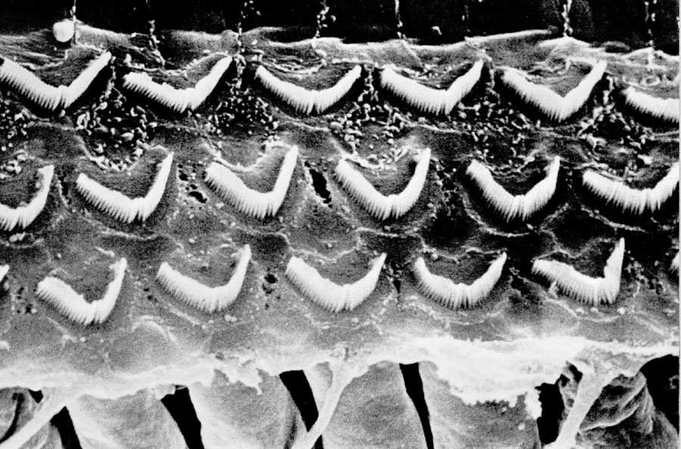
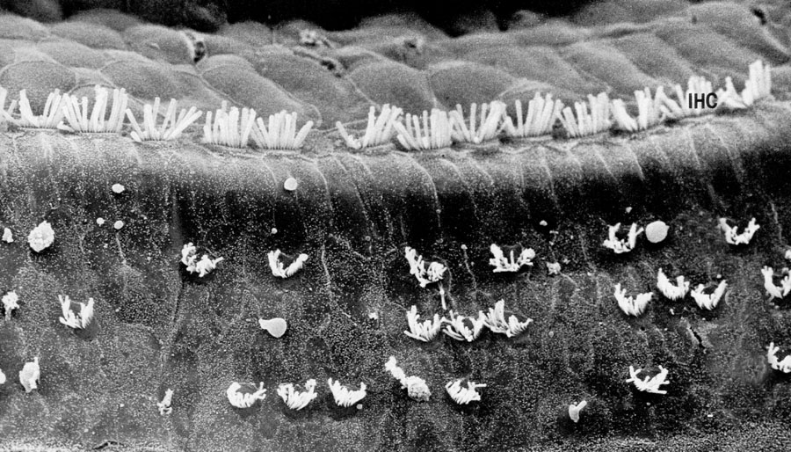
INSIDE THE COCHLEA
Healthy Hair Cells
(Hearing Nerve Endings)
Hair Cells Damaged by Noise
(Hearing Nerve Endings)
Damage!
Notes:
The first picture is one of healthy hair cells in the cochlea. The second picture is what it looks like after noise damage. Many of the hair cells are gone (and will not grow back). Now the hair cells are missing, so when the basilar membrane and tectorial membrane try to shear them, there’s nothing to bend and cause the nerve to fire = hearing loss. The bent hair cells are stuck in the shearing position, which means the nerve underneath thinks they’re bending in response to a sound, so it fires over and over again = tinnitus or ringing in the ears.
The hearing loss from noise exposure always starts in the high pitches (the about 2/3rds of the way across the piano, on the right side, where the keys are higher pitched). What that means is the employees lose the ability to hear several speech sounds (s, sh, t, k, ch, f, h). These are the speech sounds that make it easy for us to understand speech when there’s background noise (such as, trying to hear over a two-way radio). Next, localization is affected. Some soft sounds are really hard to hear, like the subtle movements of people walking nearby or mechanical noise in equipment that needs to be repaired. Hearing loss from noise could affect your ability to hear safety warnings on the job.

Slide 9
Tinnitus from Noise Exposure
Exposure to high noise levels can also cause permanent ringing or noise in the ear called “tinnitus”
Tinnitus sufferers usually complain of constant whistling, squealing, roaring, or buzzing in one or both ears
Severe tinnitus may disrupt sleep, reduce concentration, and cause irritability or depression
Notes:
There is no cure for tinnitus. However, there are several treatments that can provide some relief. Discuss your tinnitus symptoms with your Hearing Program Manager or healthcare provider so they can advise you regarding medical follow up or referral.

Slide 10
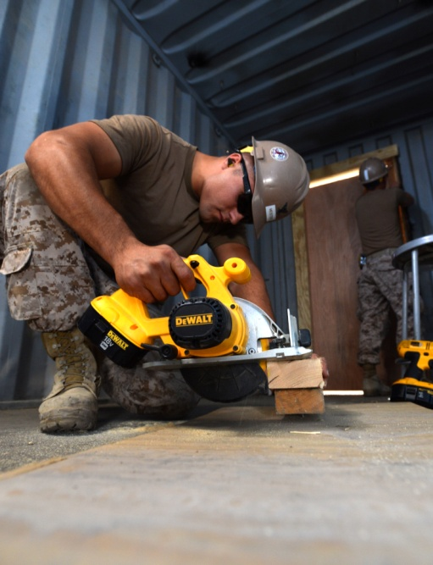
HAZARDOUS NOISE LEVELS
Noise Levels which Cause Hair Cell Damage:
Steady-state Noise > 85 dBA
Steady-state Noise = Noise > ½ second in duration
Most generators
Rotary wing aircraft
Lawn mowers, jack hammers, circular saws
Tends to cause gradual hearing loss
Impulse/Impact Noise >140 dBpSPL
Explosions
All Weapons
Can be gradual or sudden hearing loss
Photo Courtesy of US Navy
Notes:
The risk of hearing loss increases dramatically as noise levels increase. Exposure to noise levels above 115 decibels for even five minutes is very risky. Impact or banging noise above 140 decibels will cause immediate damage to nerves in the ear.
a. Impulse/Impact Noise – sounds that are less that a half second (<.5 seconds). Hazardous impulse/impact noise includes all explosions and weapon fire. M16, mortars, field artillery, grenades, RPGs, etc. This type of noise can cause either sudden or gradual hearing loss.
1) Because impulse/impact noise is short, humans can tolerate more loudness before damage occurs….up to 140 decibels without hearing protection.
2) This is the type of noise employees commonly understand is dangerous and the sources in the Army are easily identified. Every single weapon exceeds the safe level. The M16 is one of the “softer” weapons, and one round is 156 decibels.
WARNING: Weapons maintain their loudness level even when firing blanks. A blank fired from an M16 is STILL 156 decibels, hearing protection must be worn for all simulated exercises regardless of ammunition used.
b. Steady-state Noise – sounds that last longer than a half second (>.5 seconds). Hazardous steady-state (or continuous) noise sources can include tactical vehicles, aircraft, generators, and even portable burners for MKTs (military kitchen trailers). This type of noise typically causes gradual hearing loss that grows steadily worse over time with continued exposure.
1) Because steady-state noise is longer, often lasting hours in the environment, humans can not tolerate as much loudness before damage occurs. Hearing protection must be worn whenever the noise source exceeds 85 decibels (>85).
2) The damaging effects of this type of noise are the least understood by employees, yet exposures to steady-state noise are the most common in the Army (convoys, flights, generators powering sleeps tents and tactical operation centers, motor pools, flight lines, etc.). It is also more difficult to determine when the safe level of 85 decibels is exceeded. To determine if safe levels of noise have been exceeded for steady state noise, there is a simple “Rule of Thumb” that can be used (next slide).
WARNING: A four hour convoy ride in a HMMWV at 40 mph exposes the employee to 95 decibels of noise on a continuous basis. The trauma from that exposure can cause as much damage to hearing as an IED.

Slide 11
Noise Level Examples
Fire crackers, weapons fire…………………………….140 dB+
Jack hammer…………………………………………..130 dB
Jet plan………………………………………….……120 dB
Rock concert……………………..........................110 dB
Snow mobile, chain saw………………………..100 dB
Tractor……………………………………………95 dB
Lawn mower, motor cycle……………………90 dB
Busy Traffic………………………………….70 dB
Normal Conversation……………………..60 dB
Quiet room…………………………….…40 dB
Whisper……………………………….30 dB
LOUD
SOFT
Notes:
Noise levels are approximate

Slide 12
HAZARDOUS NOISE LEVELS
Three Foot Rule
(For Steady State Noise)
If the sound is so loud that you must raise your voice to be understood at a distance of three feet it is…
POTENTIALLY HAZARDOUS
Fact: The exposure to engine noise in a 4-hour convoy can be as damaging to hearing as one IED
Notes:
Easy way for the employee to determine if a noise level is dangerous without needing to use a sound level meter.

Slide 13
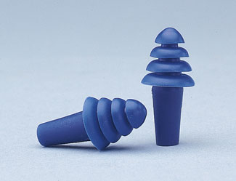
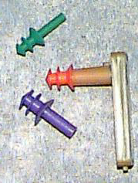
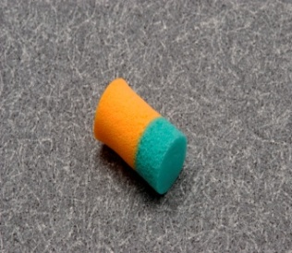
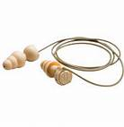
HEARING PROTECTION
Earplugs
Pre-formed
Single Flange
Triple Flange
Quad Flange
Combat Arms Earplugs
Hand-formed (foam)
Proper Fit:
Pull Back on Ear to Straighten Ear Canal
Vacuum Seal – hollow sounding or like
you have a “head cold”
Earmuffs
Adjust headband for a snug fit
Combat Arms
Flattened switch for engines, generators, vehicles
Open switch for metal-on-metal, weapons fire
Notes:
In order to mitigate the threat of damage to hearing from hazardous noise, the dangerous sounds must be stopped before reaching the eardrum and setting the chain into motion. That is done effectively with well-fit hearing protection. Earplugs must be fit individually to each employee since size varies between individuals in the same way shoe size varies. A employee may even have two different sized ears that require different earplugs for a proper fit. The type of hearing protection recommended will depend on the type of work that you do and your noise exposures.
a. employees need to use the proper size of earplug to protect their hearing. Once fit by trained personnel, they need to remember their size for future fittings/purchases. How do they know what size they are? By the color.
b. Earplugs are like a plug in a sink, if the plug is too big or too small, the water will leak out. Noise will follow the same open pathways and reach the eardrum unhindered if the earplug is too small or too big.
c. Proper insertion of the earplugs requires a straightening of the ear canal. The human ear canal is “s” shaped to protect the eardrum, if it isn’t straightened, the earplug will hit the first wall and not fit snugly or fall out. Pull back and up on the ear with the opposite hand while inserting the earplug. Make sure it is inserted until a tight seal (not painful) is obtained on both sides.
d. If the earplugs are fitting properly, the employee should be able to do a self-check of the fit. The employee is to test for an “occlusion effect”, which means his/her own voice should sound loud in his head (like he has a ‘head cold’) and his breathing should be abnormally loud. Everything else around him should sound lower or muffled. He should still have environmental awareness and understand speech, but it should sound softer overall.
e. There are different types of earplugs, including the standard preformed (triple flange, quad flange and single flange), hand formed (foam), combat arms earplugs (CAEs), and tactical communication and protective systems (TCAPS). All perform similar functions (protect hearing) but impact communication differently.
f. The combat arms earplugs allow employees to change the settings based on the type of noise present. In the “combat” setting, employees can hear voices and radios normally (or low level sounds in combat), but when a weapon is fired or an explosion occurs, the noise is dissipated by the tubing in the earplug before it reaches the eardrum. It allows the employee to maintain situational awareness “outside the wire”, but still be protected from weapon fire. If the hazardous noise is steady-state, meaning continuous (i.e.; generators, vehicle engines or aircraft), the setting on the CAE can be changed to become a regular earplug that prevents the hazardous, continuous noise from reaching the eardrum.
g. Earmuffs should be checked prior to use for any damage. The pads on the earmuffs can become flattened, cracked or break down over time resulting in a poor seal on the head and noise leakage into the ear.

Slide 14
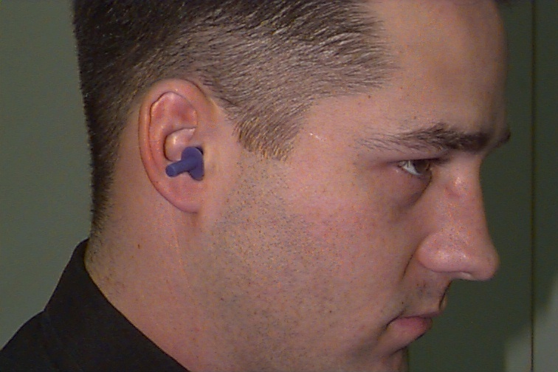
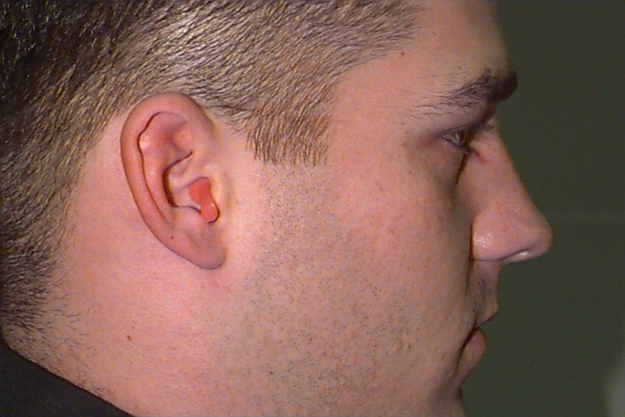
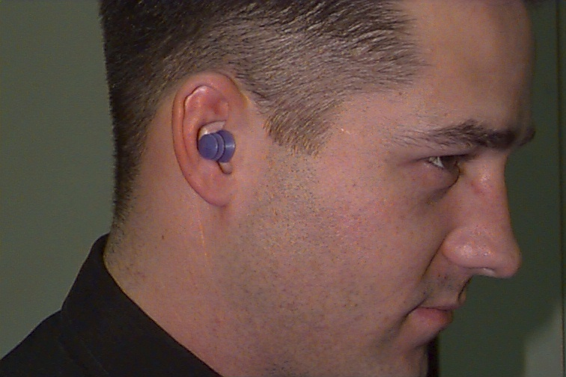
How’s the fit?
Triple Flange Earplugs
with
Insertion Tool
2
1
3
Notes:
Picture #1 Good fit/bad fit? Answer: bad fit. Picture #1 Good fit/bad fit? Answer: good fit. The last flange is sealing the opening of the ear canal and the employee is able to perceive the occlusion effect.
Picture #2. Good fit/bad fit? Answer: bad fit. The earplug is too big, the last flange isn’t able to seal the opening of the ear canal because it can’t be inserted deep enough. An earplug that is too big also cannot obtain a proper seal for protection.
Picture #3. Good fit/bad fit? Answer: bad fit. The earplug is inserted backwards with the stem in the ear canal.
WARNING: One of the most obvious signs of an earplug that is too big is if the flange is folding over on itself. The groove in the earplug actually creates and holds open an entryway for noise. If the earplug is folded in anyway, the employee needs the next size down

Slide 15
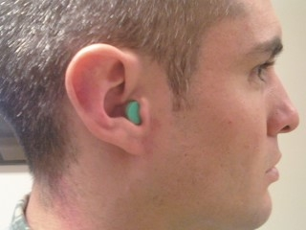
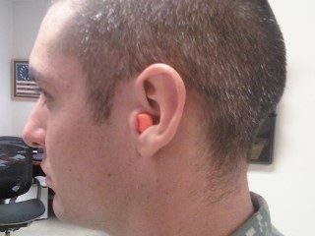
How’s the fit?
2
Bi-Colored
Foam Earplug
1
3
Notes:
Foam earplugs have both advantages and disadvantages. Advantages include comfort and the universal fit of the majority of individuals. Disadvantages include the availability (not all noise hazardous areas have foam earplugs available), one-time use (raises cost of supplying units), and the high likelihood of inadequate insertion for protection.
Picture #1. Good fit/bad fit? Answer: bad fit. The foam earplug is not inserted deep enough. For a dual-colored earplug, proper insertion is assured when no “orange” is showing, only green. With a single-colored earplug, use the tragus as a point of reference (the tragus is the small piece of cartilage that sits at the front of the ear canal). If the foam earplug is past the tragus, it needs to be re-inserted. The employee should not look like Frankenstein’s neck bolts have been moved to his ears!
Picture #2. Good fit/bad fit? Answer: good fit. Only green is showing and the earplug is in the ear canal past the tragus.
Picture #3. Good fit/bad fit? Answer: Bad fit. The orange is showing which indicates the earplug is in backwards.
WARNING: Foam earplugs do not fit everyone, especially if the employee has a small ear canal. The earplug cannot be altered (i.e.; cut or trimmed) without compromising protection. If the earplug has to be altered to obtain a good fit, it cannot be used by that employee.

Slide 16
Hearing Protection in Background Noise
Using earmuffs or plugs in noisy areas
can actually make it easier to hear
coworkers or machinery
Hearing protectors reduce loud
background noise; decreasing worker
stress from noise,
and improving communication
Photo Courtesy of CDC PHIL
Notes:
Loud background noise can overwhelm the ears making it difficult to hear a coworker. When used correctly earplugs or muffs mute the background noise so that a coworker or a warning bell from a truck backing up will be easier to hear.
Earmuffs and plugs provide good protection only when used properly. Sometimes people will remove hearing protection for “just a minute” in a noisy area. This could result in noise overexposure.

Slide 17
Audiometric (Hearing)Testing
Establish individual fitness for duty
Detect changes in hearing early
Ensure proper medical referrals and diagnoses
Monitor the effectiveness of the local hearing program to keep employees safe
Comply with Federal regulations (OSHA)
Notes:
Audiometric testing is required of all employees exposed to 8-hour average noise levels of 85 decibels or above.
Audiometric testing detects changes in hearing early. Excessive noise exposure can occur at work or at home. Home activities that include exposure to excessive noise include use of woodworking equipment or chain saws, gun target practice, motorcycle riding, attending rock concerts, or listening to loud music through headphones.

Slide 18
Audiometric Testing
Audiometric testing results can be used to check the following:
The adequacy of hearing protection being used
A diagnostic hearing evaluation determines whether a hearing loss is present, the type of hearing loss, and whether a referral to a medical doctor is necessary
Notes:
Hearing loss can also be caused by other reasons such as ear infections, excessive wax in the ear, or other medical conditions. If a hearing loss is detected through audiometric testing, you will be referred for a diagnostic hearing evaluation.
OSHA requires employers to provide annual audiograms within year of the baseline test. Workers’ hearing is tested annually to identify a change in their hearing ability as early as possible. This enables employers to initiate protective follow-up measures before hearing loss progresses. Employers must compare annual audiograms to baseline audiograms to determine whether the audiogram is valid and whether the employee has lost hearing ability or experienced a standard threshold shift (STS). An STS is an average shift in either ear of 10 dB or more at 2,000, 3,000, and 4,000 Hz.

Slide 19
Noise Measurements
Noise measures are made to evaluate the potential for an exposure to cause hearing loss
A person’s total involvement with noise, not just a momentary level
Noise Level, dBA | Permitted daily exposure time
85 | 8 HOURS
88 | 4 HOURS
91 | 2 HOUR
94 | 1 HOUR
97 | 30 MINUTES
100 | 15 MINUTES
103 | 7.5 MINUTES

Slide 20
Recordkeeping
Employers are required by OSHA to keep all records involving noise measurements for at least two years
Employers are required by OSHA to keep any information regarding employee testing and training for the duration of employment
OSHA also requires the employer to maintain records of any employee who is documented to have a decrease in hearing
Notes:
OSHA is the Occupational Safety and Health Administration. DA PAM 40-501 requires employers to keep any information regarding employee testing and training for the duration of employment plus 30 years.

Slide 21
CONCLUSION
Noise induced Hearing Loss is NOT inevitable
Using hearing protection is crucial to preventing hearing loss
The ability to understand speech increases when background noise is reduced
You have the right to see noise measurement records and get copies of your hearing test results

Slide 22
Hearing Loss is:
Painless
Permanent
Progressive
Preventable!

